Slide 1



Spark Scenario Based Interview Question
Persistence Vs Broadcast

Slide 2
Persistence Vs BroadCast
Interview Questions could be :
We all know that broadcast is good, expedites the Joins , results in No Shuffling of the data , but we have to be careful with broadcast from the memory utilization perspective, How and Why?
Or
What is the difference between the Persist and the broadcast, primarily from the memory footprint perspective ?
Or
What could be the problem with the broadcast ?

Slide 3
Persistence Vs BroadCast
Let’s run out a specific scenarios to find the answers to these questions:
Suppose we have a Dataset of 12G with 6 partition. What would be the specific memory footprint in spark context for :
In the case of Persist and
In the case of broadcast

Slide 4
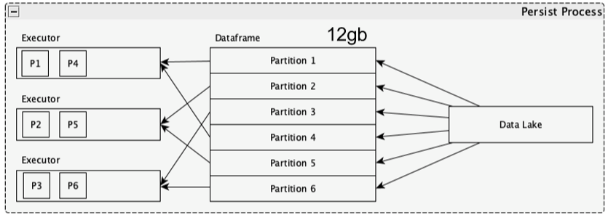

Persistence Vs BroadCast
Let see how persist will work
Memory footprint is – 12G

Slide 5
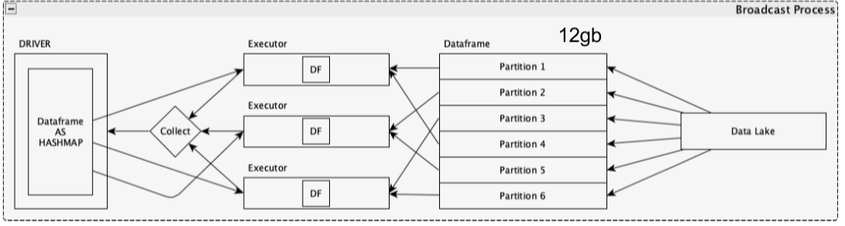
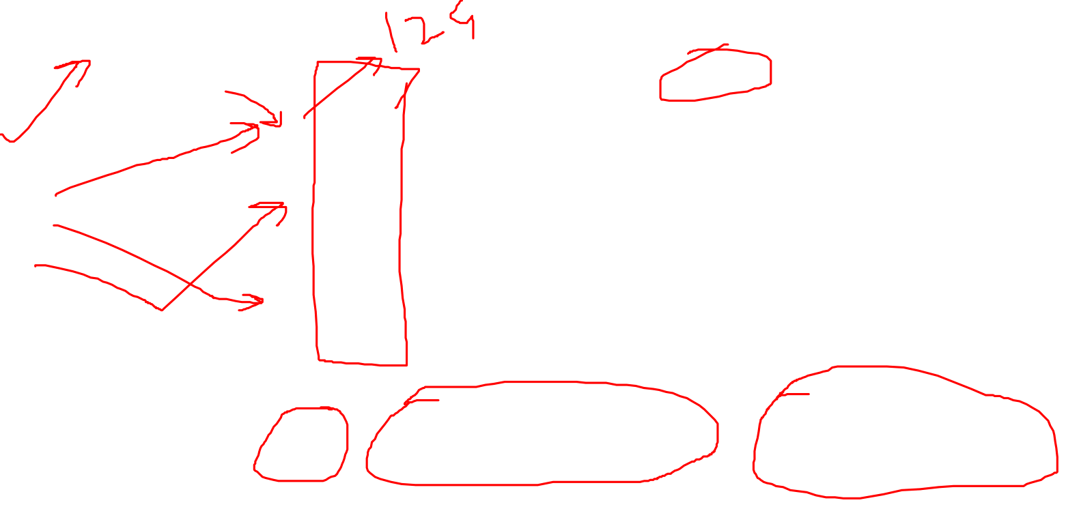
Persistence Vs BroadCast
Let see how persist will work
Memory footprint is – 48 G = 36G(BroadCast data) + 12G(Existing DF)

Slide 6
Persistence Vs BroadCast
Conclusion :
Always work out the memory footprint validation, whenever trying to do the explicit data broadcast.

Slide 7
Cache Vs Persist
Thanks and do subscribe to my channel

